Slide 1
Orthogonal Matching Pursuit A Machine Learning Perspective
Slides: Team RAAAK

Slide 2

Outliers
This Photo by Unknown Author is licensed under CC BY-NC-ND

Slide 3
Outliers in Linear Models
Samples that deviate strongly from the general pattern of our data

Slide 4
Outliers in Linear Models
Samples that deviate strongly from the general pattern of our data
Not well explained by our linear model

Slide 5
Outliers in Linear Models
Samples that deviate strongly from the general pattern of our data
Not well explained by our linear model
Sources of outliers include:
Errors in measurement or data entry

Slide 6
Outliers in Linear Models
Samples that deviate strongly from the general pattern of our data
Not well explained by our linear model
Sources of outliers include:
Errors in measurement or data entry
Sampling errors

Slide 7
Outliers in Linear Models
Samples that deviate strongly from the general pattern of our data
Not well explained by our linear model
Sources of outliers include:
Errors in measurement or data entry
Sampling errors
Noise in our data that corrupts our true observation

Slide 8
The Impact of Outliers
Outliers can drive up the error of our model!
Cause us to not represent the true pattern of our data

Slide 9

The Impact of Outliers
Outliers can drive up the error of our model!
Cause us to not represent the true pattern of our data

Slide 10




The Impact of Outliers
Outliers can drive up the error of our model!
Cause us to not represent the true pattern of our data

Slide 11
Facts About OMP – A 16A Review
Goal: Solve a LS problem to get a sparse solution
01
Sparse: containing mostly zero entries
02
K-sparse vector: k controls the number of nonzero entries
03
Assumption: the columns of X (data matrix) are normalized
04
Property: OMP is a Greedy Algorithm
05

Slide 12

OMP Review – Signal Processing Context
You have seen this interpretation in EECS16A
Context:
m satellites that are potentially broadcasting unique signals
A received signal that is a linear combination of a subset of these signals
This Photo by Unknown Author is licensed under CC BY-SA-NC

Slide 13
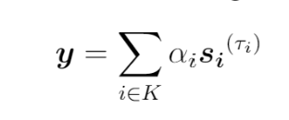
OMP Review – Signal Processing Context
You have seen this interpretation in EECS16A
What we’re given:
m satellites that are potentially broadcasting unique signals
A received signal that is a linear combination of a subset of these signals
Goal
find which k satellites are transmitting signals that are present in our received signal

Slide 14
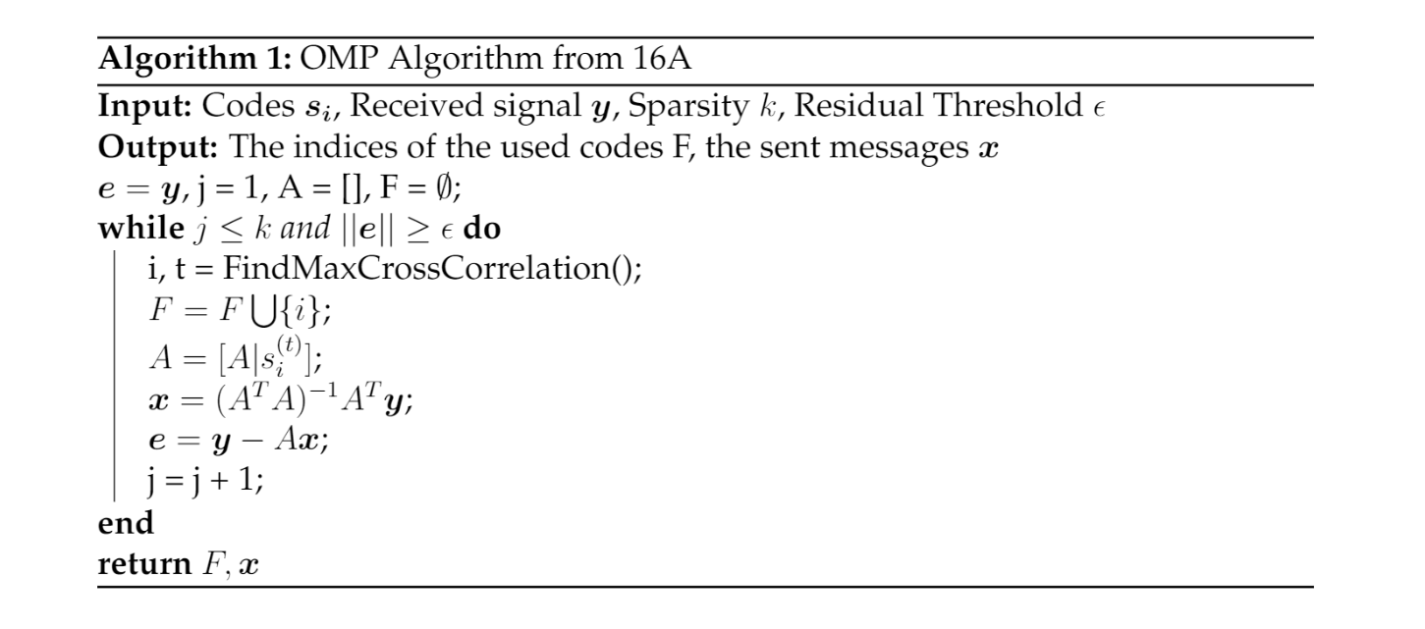
OMP Review - Algorithm

Slide 15
OMP Review - Algorithm
Recall: We find the code and time shift with the maximum cross-correlation to predict one satellite that contributes to our received signal

Slide 16

The Problem of Outlier Detection
We would like to identify and remove outlier data points to decrease model error

Slide 17

Outlier Detection: An Analogous Context
Codes
In our new problem, codes correspond to our matrix $X$ of data

Slide 18

Outlier Detection: An Analogous Context
Codes
In our new problem, codes correspond to our matrix $X$ of data
Message $α$
Rather than recover a message broadcasted by satellites, we aim to learn an appropriate set of weights $w$

Slide 19

Outlier Detection: An Analogous Context
Codes
In our new problem, codes correspond to our matrix $X$ of data
Message $α$
Rather than recover a message broadcasted by satellites, we aim to learn an appropriate set of weights $w$
Time shifts $τ_{i}$
In Outlier Detection, we no longer have the problem of time delays that we saw in the signal processing context
This means we no longer have to compute any cross-correlation values

Slide 20

Outlier Detection: An Analogous Context
Codes
In our new problem, codes correspond to our matrix $X$ of data
Message $α$
Rather than recover a message broadcasted by satellites, we aim to learn an appropriate set of weights $w$
Time shifts $τ_{i}$
In Outlier Detection, we no longer have the problem of time delays that we saw in the signal processing context
This means we no longer have to compute any cross-correlation values
Meaning of k
Previously, we thought of k as related to the number of satellites transmitting unique codes
Now, k refers to the number of outliers we aim to detect

Slide 21
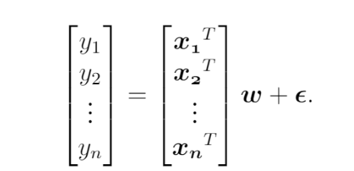



OMP for Outlier Detection – Initial Setup

Slide 22





OMP for Outlier Detection – Initial Setup

Slide 23










OMP for Outlier Detection – Initial Setup

Slide 24




OMP for Outlier Detection – Initial Setup

Slide 25
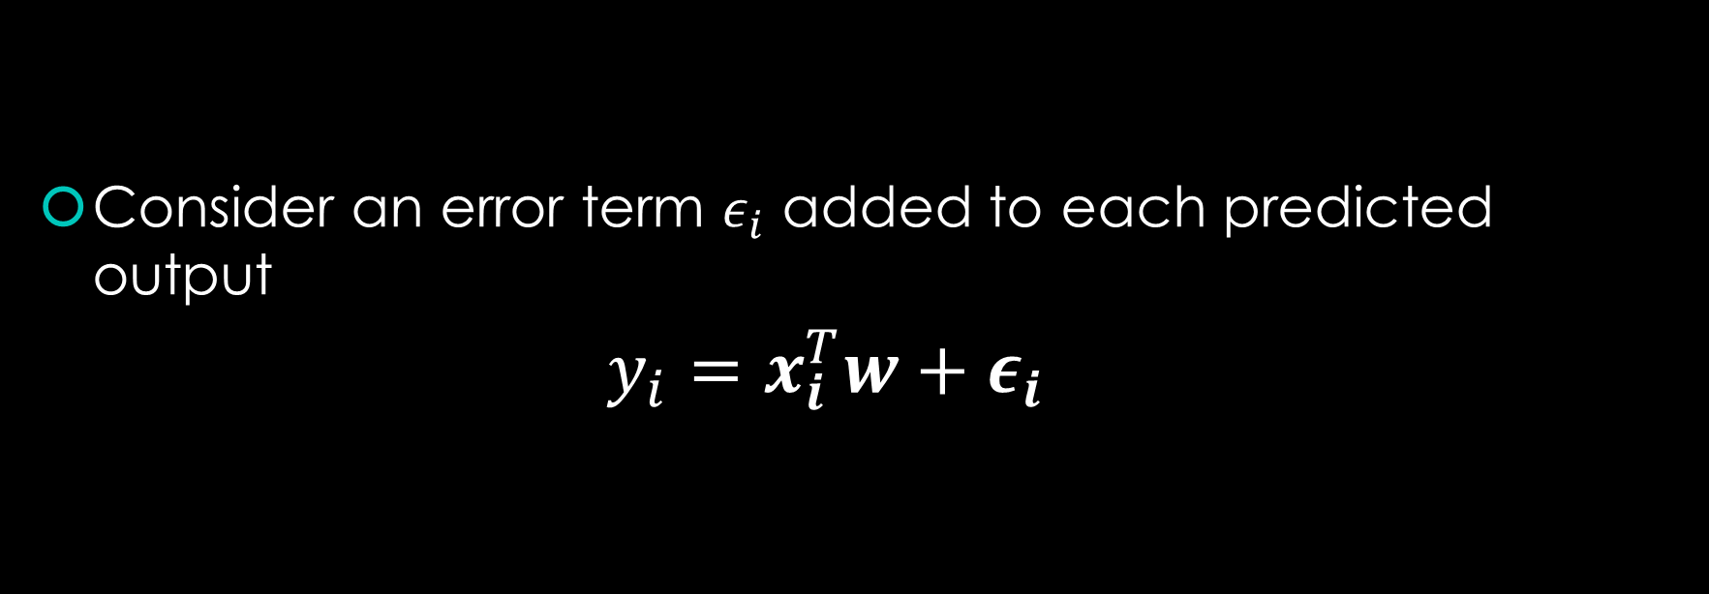
OMP for Outlier Detection – Error & Residuals
Consider an error term $ε_{i}$ added to each predicted output
$$y_{i}=x_{i}^{T}w+ε_{i}$$

Slide 26
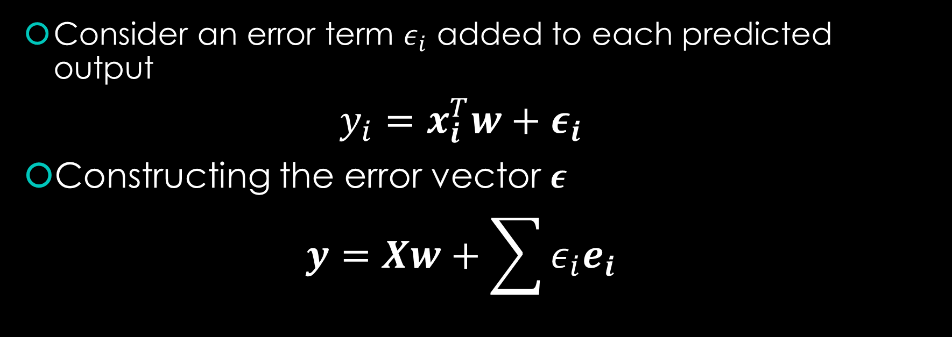
OMP for Outlier Detection – Error & Residuals
Consider an error term $ε_{i}$ added to each predicted output
$$y_{i}=x_{i}^{T}w+ε_{i}$$
Constructing the error vector $ε$
$$y=Xw+\sum{ε_{i}e_{i}}$$

Slide 27



OMP for Outlier Detection – Error & Residuals
Consider an error term $ε_{i}$ added to each predicted output
$$y_{i}=x_{i}^{T}w+ε_{i}$$
Constructing the error vector $ε$
$$y=Xw+\sum{ε_{i}e_{i}}$$
Matrix-vector product form
$\left[X I\right][\begin{matrix}w \\ ε\end{matrix}$]

Slide 28

OMP for Outlier Detection – Error & Residuals
$\left[X I\right][\begin{matrix}w \\ ε\end{matrix}$]
Note: We assume there are only a few outliers, so $ε$ contains only a few large values

Slide 29

OMP for Outlier Detection – Inputs
Data
Given in the form of a data matrix $X$
And targets $y$
Desired sparsity $k$ of our solution
Potentially also a desired threshold (more on this later)

Slide 30

OMP for Outlier Detection – Outputs
A set of indices in our data that correspond to outlier data points
We’ll call this $F$

Slide 31

The Algorithm: Initialization
Residual $r$
Residual 𝑟
Matrix $A$
Matrix 𝐴
Outlier Set $F$
Outlier Set 𝐹

Slide 32
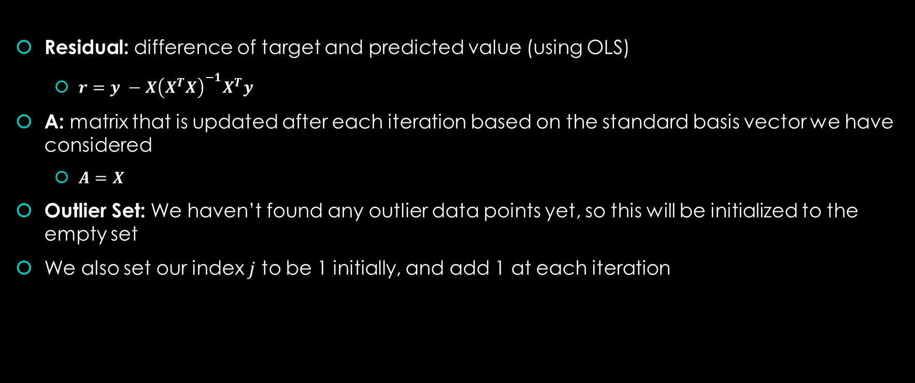
OMP: Initial Values
Residual: difference of target and predicted value (using OLS)
$r=y −X{\left(X^{T}X\right)}^{−1}X^{T}y$
A: matrix that is updated after each iteration based on the standard basis vector we have considered
$A=X$
Outlier Set: We haven’t found any outlier data points yet, so this will be initialized to the empty set
We also set our index $j$ to be 1 initially, and add 1 at each iteration

Slide 33
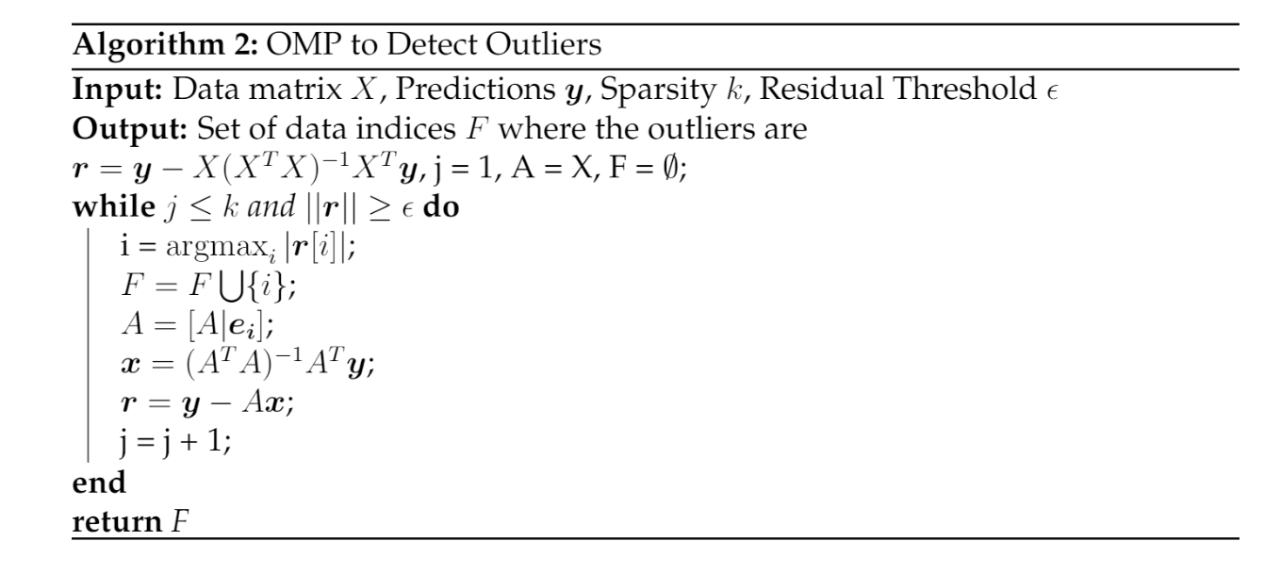



OMP: The Algorithm So Far

Slide 34



Identifying an index
We’d like to pinpoint the index $i$with the largest error value (captured by our residual)
How would we do this?
Check for understanding: what should replace the red question mark below?

Slide 35

Identifying an index
We’d like to pinpoint the index $i$with the largest error value (captured by our residual)
How would we do this?
We take the inner product of the residual with the i’th standard basis vector

Slide 36
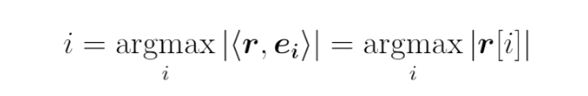
This simplifies to the i’th index of the residual, which we add to our set of outlier indices

Slide 37


OMP: The Algorithm So Far

Slide 38

Augmenting A
We’ve pinpointed the i’th standard basis vector to have the maximum inner product with our residual
So, we augment A by appending the i’th standard basis vector as follows:

Slide 39
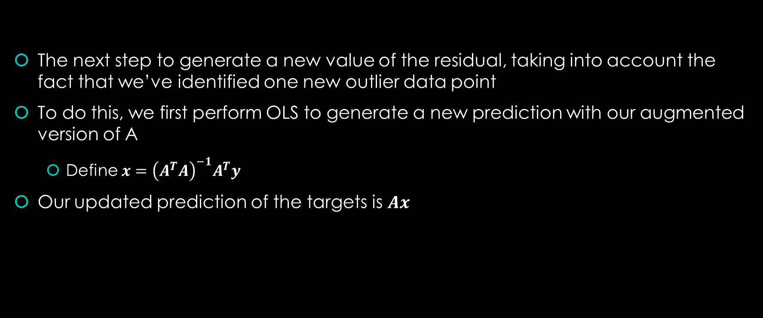
Recomputing the Residual
The next step to generate a new value of the residual, taking into account the fact that we’ve identified one new outlier data point
To do this, we first perform OLS to generate a new prediction with our augmented version of A
Define $x={\left(A^{T}A\right)}^{−1}A^{T}y$
Our updated prediction of the targets is $Ax$

Slide 40
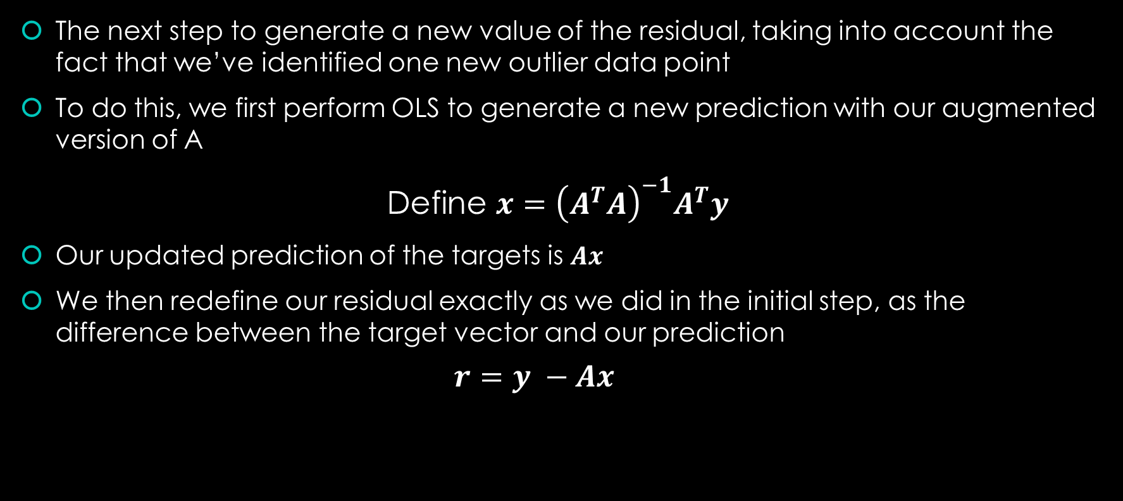
Recomputing the Residual
The next step to generate a new value of the residual, taking into account the fact that we’ve identified one new outlier data point
To do this, we first perform OLS to generate a new prediction with our augmented version of A
Define $x={\left(A^{T}A\right)}^{−1}A^{T}y$
Our updated prediction of the targets is $Ax$
We then redefine our residual exactly as we did in the initial step, as the difference between the target vector and our prediction
$$r=y −Ax$$

Slide 41


OMP: The Algorithm So Far

Slide 42
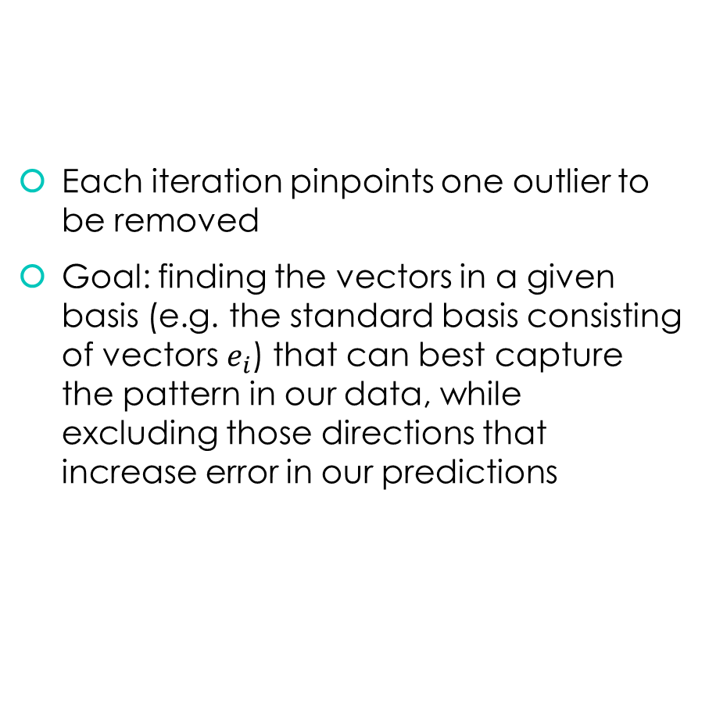
OMP for Outlier Detection – Big Picture
Each iteration pinpoints one outlier to be removed
Goal: finding the vectors in a given basis (e.g. the standard basis consisting of vectors $e_{i}$) that can best capture the pattern in our data, while excluding those directions that increase error in our predictions

Slide 43
OMP for Outlier Detection and Removal - Visualization

Slide 44
OMP for Outlier Detection and Removal - Visualization

Slide 45
OMP for Outlier Detection and Removal - Visualization

Slide 46

After Several Iterations…

Slide 47

Question
How do we know when to stop running Orthogonal Matching Pursuit for outlier detection?

Slide 48

Stopping Conditions
Option 1: Stop after a certain number of outliers are removed
This is especially helpful when we have an idea of how many outliers exist in our data
How does this affect our algorithm?
For k outliers, iterate while $j≤k$

Slide 49

Stopping Conditions
Option 1: Stop after a certain number of outliers are removed
This is especially helpful when we have an idea of how many outliers exist in our data
How does this affect our algorithm?
For k outliers, iterate while $j≤k$
Option 2: stop once we’ve reached a certain residual threshold
Stop iterating when the norm of our residual $r$ falls below a predefined value $ε$
How does this affect our algorithm?
Iterate while $\left\|r\right\|≥ε$

Slide 50
Note: the values of k and epsilon are set by us, and are not a quantity determined by the OMP algorithm.
This means we can tune them!

Slide 51
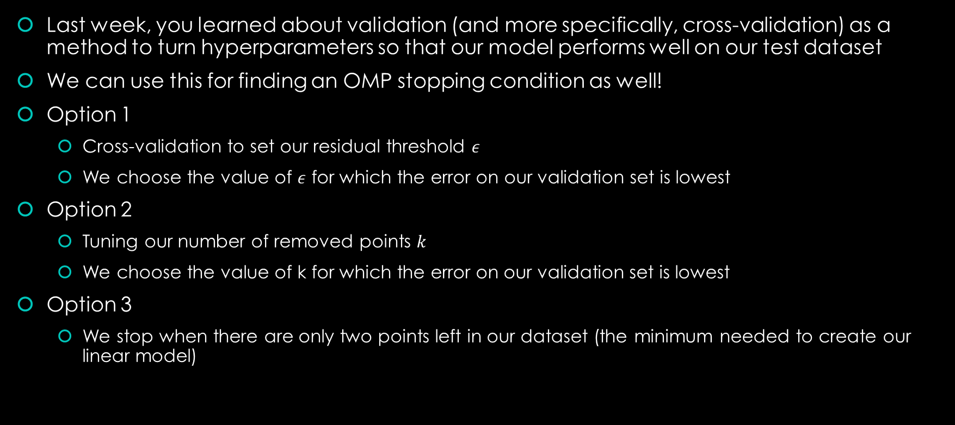
Tuning our Stopping Condition
Last week, you learned about validation (and more specifically, cross-validation) as a method to turn hyperparameters so that our model performs well on our test dataset
We can use this for finding an OMP stopping condition as well!
Option 1
Cross-validation to set our residual threshold $ε$
We choose the value of $ε$ for which the error on our validation set is lowest
Option 2
Tuning our number of removed points $k$
We choose the value of k for which the error on our validation set is lowest
Option 3
We stop when there are only two points left in our dataset (the minimum needed to create our linear model)

Slide 52
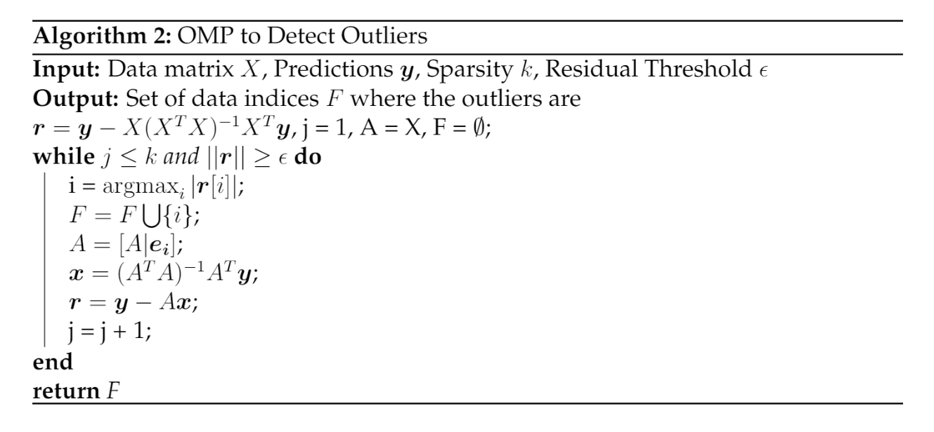
OMP for Outlier Detection – Putting it all together

